Slide 1


Results of the spatial simulation experiment for IO YFT
IATTC team (SS3 areas-as-fleets × VAST)
Spatial Simulation Experiment Webinar
October 13, 2022

Slide 2

Outline
Introduction
Progress update
Data
Model setup
Model results
Model diagnostics
Expand model fitting to the 100 replicates
Discussion

Slide 3
Acknowledgement
Special thanks to the organizers of this spatial simulation experiment to provide this great opportunity to stock assessors to evaluate and compare different assessment approaches. A large amount of hard work, including computer coding, communication, and collaboration is needed to make this workshop possible.

Slide 4
Introduction (SS3 areas-as-fleets × VAST)
The IATTC team fits a single-stock assessment model to the simulated dataset for yellowfin tuna in the Indian Ocean - use SS 3.24 (consistent with the version of the SS data provided by the workshop)
The assessment model ignores all simulated tagging data and uses the “areas-as-fleets” approach to deal with spatially-varying fishery selectivity
The assessment model includes a number of fishery fleets and one survey fleet (a term in SS referring to a fleet that has data (e.g., abundance index and compositions) but takes no catch)
The survey fleet is added to the model to reflect the abundance and length compositions at the population level. We use VAST to fit separately to cell-level longline catch-per-unit-effort (CPUE) and length composition data simulated for the entire Indian Ocean, generating area-weighted standardized abundance index and associated length compositions for the survey fleet.
The between-region movements of yellowfin within the Indian Ocean are implicitly accounted for because the area-weighted abundance index and length compositions are computed for the entire Indian Ocean rather than for a particular region.

Slide 5
Progress update
Build assessment models and prepare assessment data in SS format
Fit those models to the single replicate
Run model diagnostics to make sure those models fit well to the single replicate
Expand the analyses to the 100 replicates
Summarize the 100 replicates’ results by assessment model
Compare estimated parameters and derived quantities among assessment models

Slide 6
Decision point analysis
Data
Define fishery fleets (areas-as-fleets)
Compute catches and associated length compositions
Define survey fleet
Compute abundance index and associated length compositions
Model
Model configurations
How to fit the model to data

Slide 7
Data: fishery fleets
Region-specific fishery fleets are the default fishery definitions
We explore simplifying the fishery definitions above by assuming one fishery fleet per gear/set type
We also explore redefining associated purse-seine fishery fleets by applying a regression tree algorithm to simulated cell-level composition data
The method was not applied to LL fleets: simulated composition data for the longline fishery has a low spatial resolution (10*20), leading to a lack of clear grouping of composition data in space
The regression tree algorithm has been implemented into an R package FishFreqTree

Slide 8
Intro to FishFreqTree
The regression tree algorithm (Lennert-Cody et al. 2010) uses recursive partitioning to search for hierarchical binary decision rules that divide the data into more homogeneous subgroups.
The binary decision rules are selected to provide the greatest decrease in the heterogeneity of the simulated length composition data (i.e., highest % variance explained)
In brief, the regression tree algorithm groups similar composition data into the same fishery, making constant selectivity an appropriate assumption for regression tree-defined fisheries.
In the algorithm, composition data are split by Lat and Lon, and optionally by Quarter + Cyclic quarter and Year
Users can specify the number of splits (number of fisheries - 1) in the algorithm
The package is available at https://github.com/HaikunXu/FishFreqTree
User manual and code demo can be found at https://github.com/HaikunXu/FishFreqTree/blob/main/manual/Manual.pdf

Slide 9
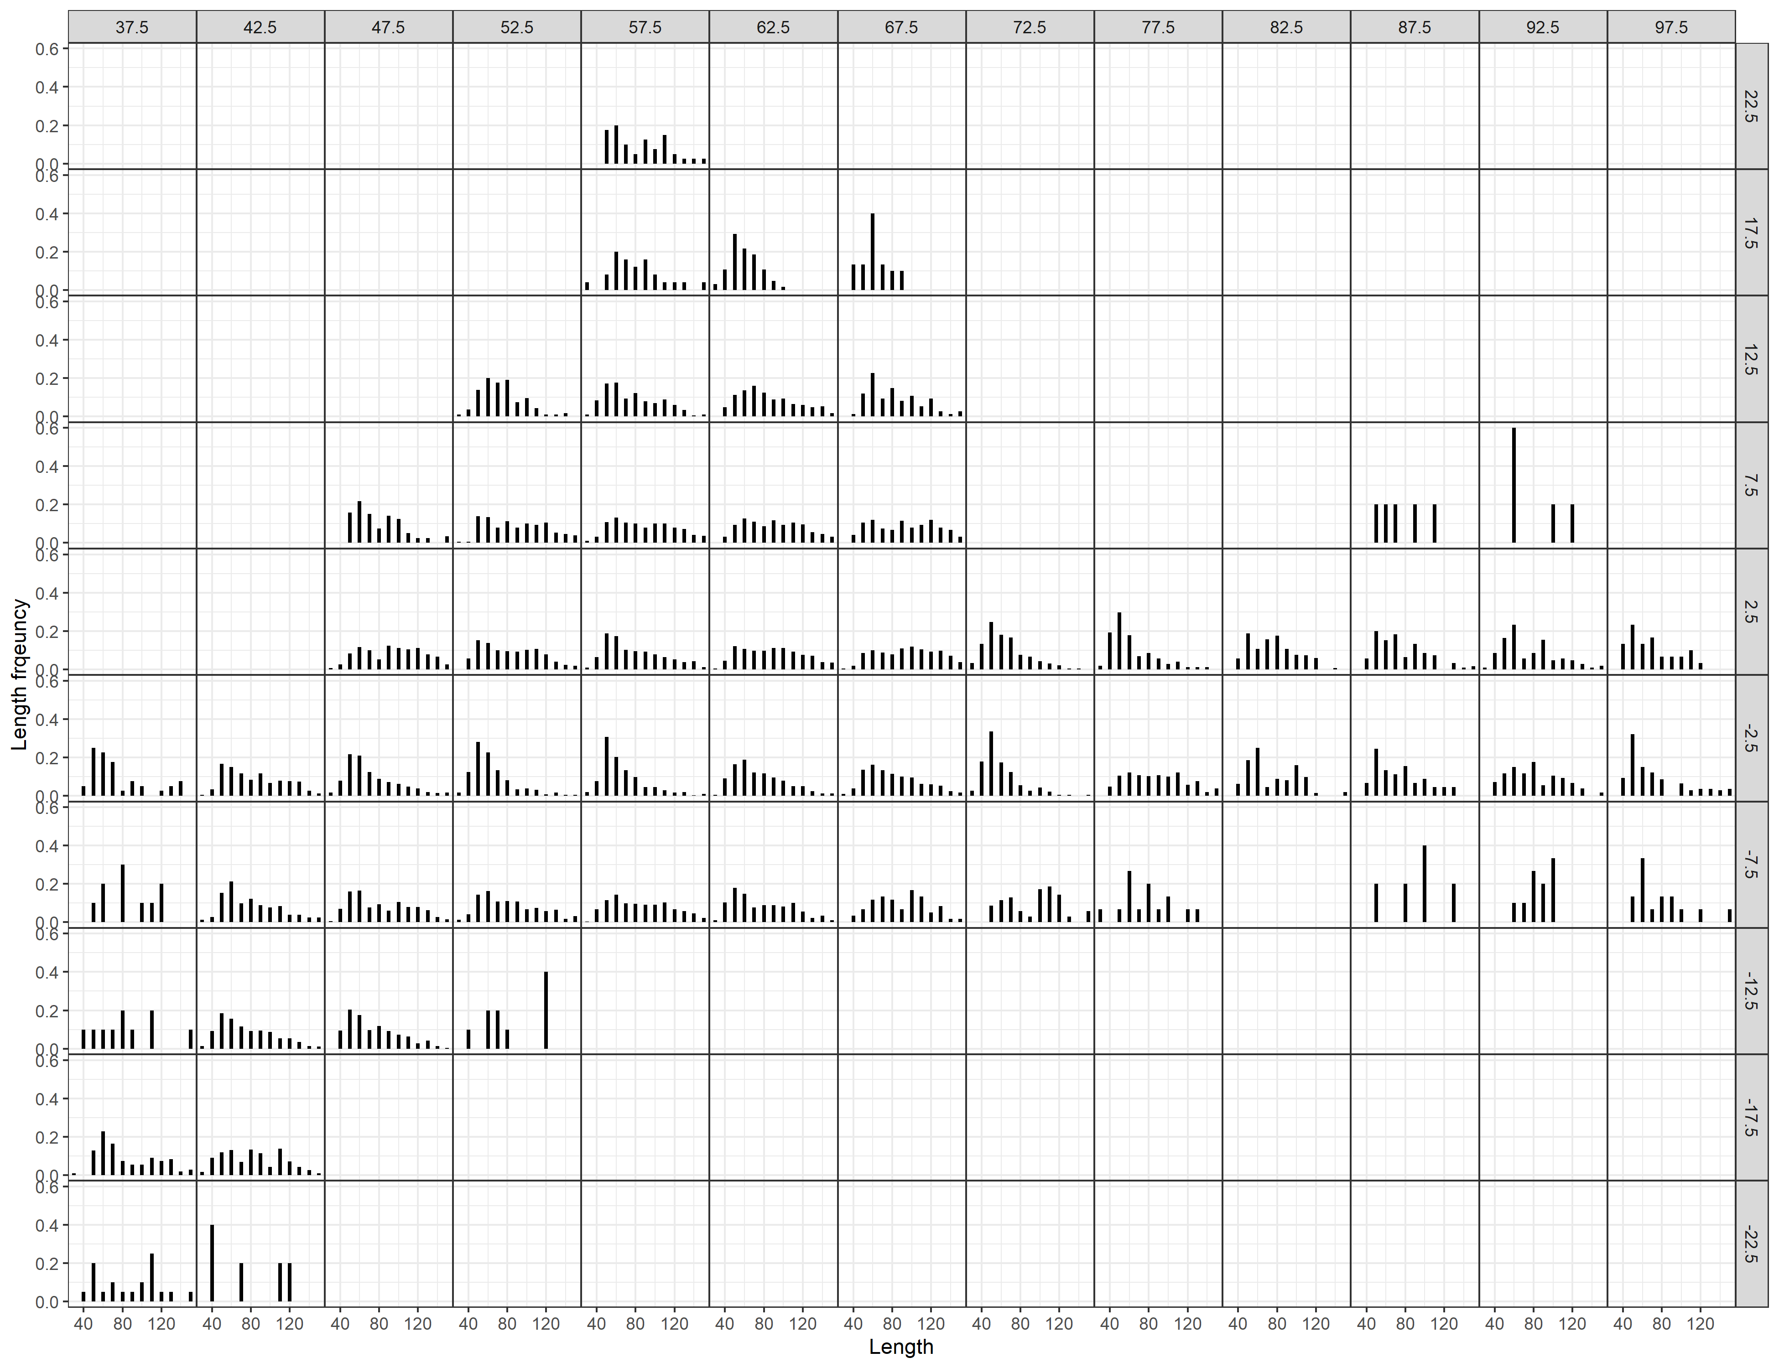
Data: fishery fleets (multiple fleets vs. one fleet per gear type)
Why multiple fleets per gear/set type?
Selectivity/availability and consequently length frequency have spatial patterns: area-as-fleets is used so that in the model fish are removed at the right size
Mean LF for associated PS

Slide 10
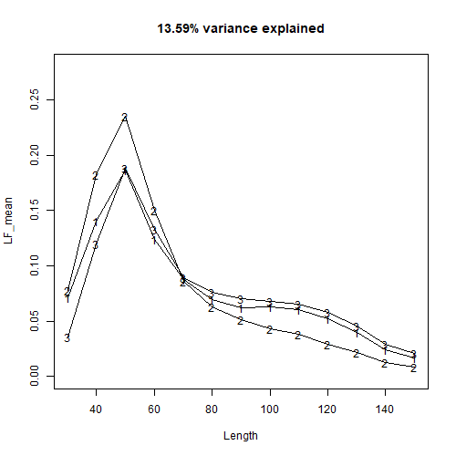
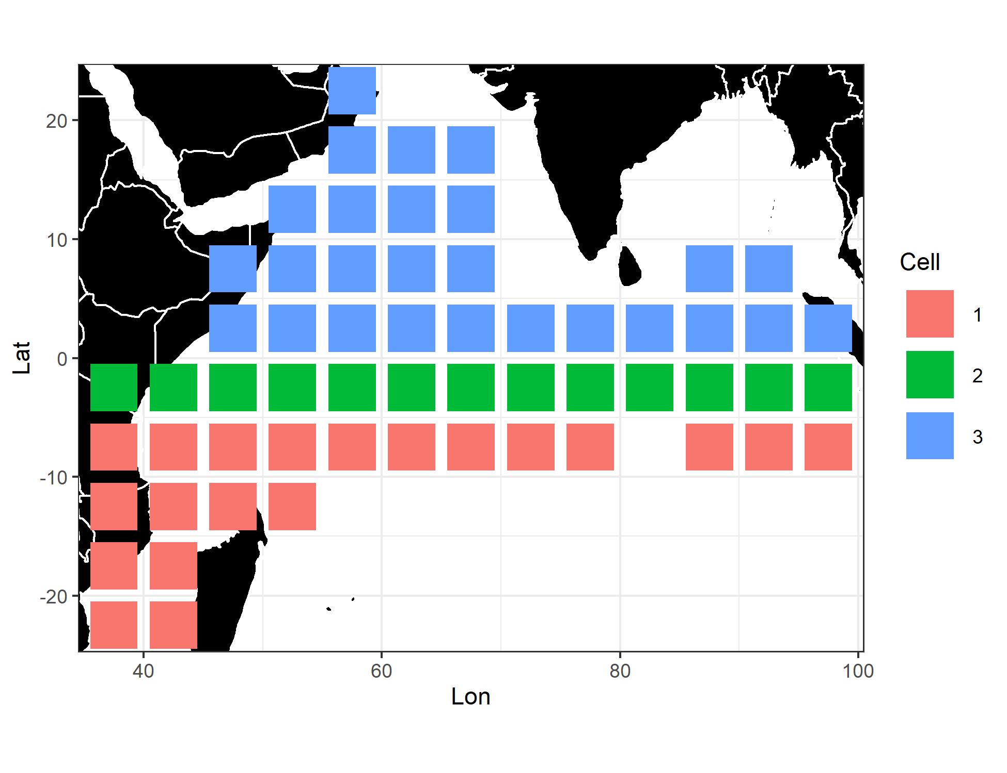
Data: fishery fleets (region-specific vs. regression-tree)
Different selectivity curves for the three associated PS fleets
Default associated PS fishery definition (R1, R2, and R4)
Regression tree-defined associated PS fisheries

Slide 11
Data: fishery fleets
Input sample sizes:
Associated PS and LL: the number of spatial cells sampled
Others: 5
Evaluate the impacts of two dimensions: 1) how to define associated PS fishery fleets and 2) how to weight fishery’s length compositions on model performance
 | One fishery per gear/set type | Three region-specific fleets (regions 1, 2, and 4) | Three regression-tree fleets
Fishery’s length comps for associated PS are sample weighted | Model sample-one | Model sample-region | Model sample-tree
Fishery’s length comps for associated PS are catch weighted | Model catch-one | Model catch-region | Model catch-tree

Slide 12
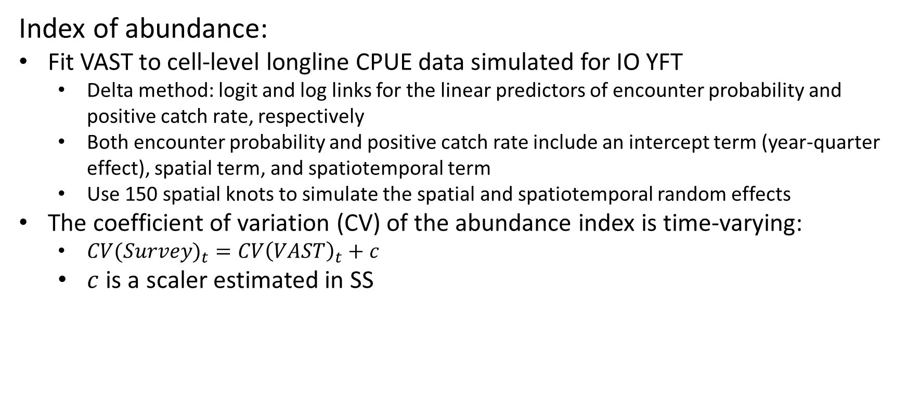
Data: survey fleet
Index of abundance:
Fit VAST to cell-level longline CPUE data simulated for IO YFT
Delta method: logit and log links for the linear predictors of encounter probability and positive catch rate, respectively
Both encounter probability and positive catch rate include an intercept term (year-quarter effect), spatial term, and spatiotemporal term
Use 150 spatial knots to simulate the spatial and spatiotemporal random effects
The coefficient of variation (CV) of the abundance index is time-varying:
${CV(Survey)}_{t}=CV{\left(VAST\right)}_{t}+c$
$c$ is a scaler estimated in SS

Slide 13
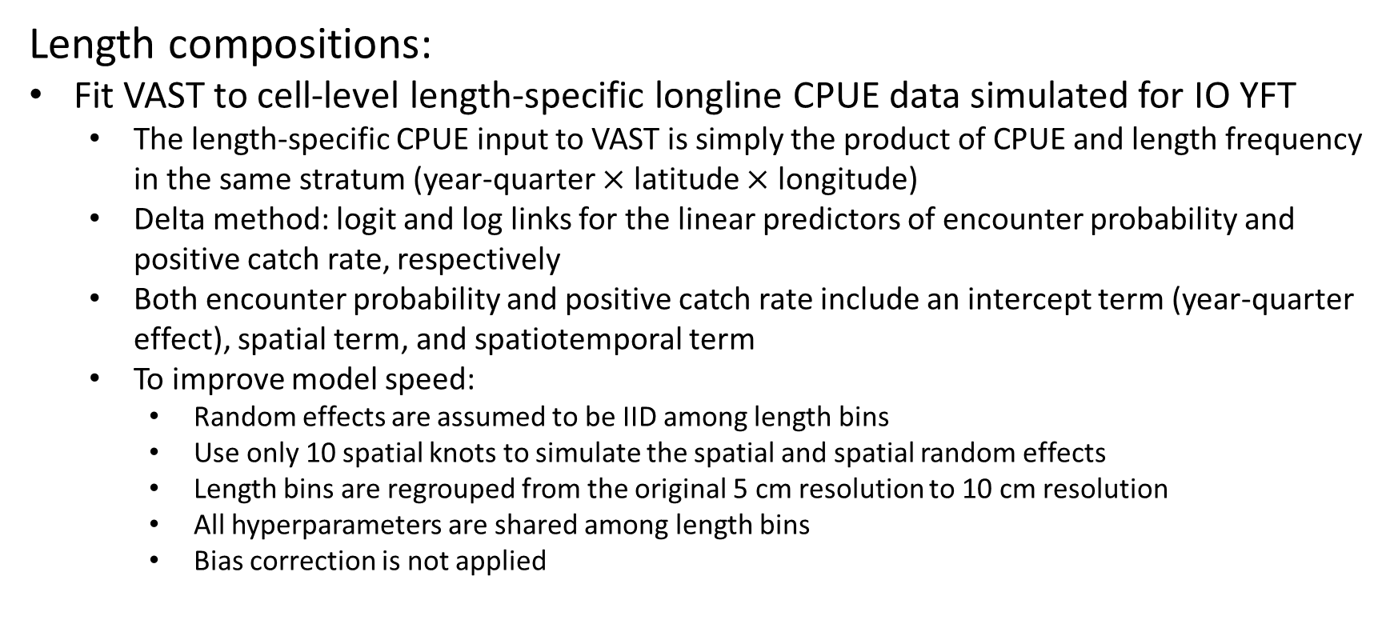
Data: survey fleet
Length compositions:
Fit VAST to cell-level length-specific longline CPUE data simulated for IO YFT
The length-specific CPUE input to VAST is simply the product of CPUE and length frequency in the same stratum (year-quarter $×$ latitude $×$ longitude)
Delta method: logit and log links for the linear predictors of encounter probability and positive catch rate, respectively
Both encounter probability and positive catch rate include an intercept term (year-quarter effect), spatial term, and spatiotemporal term
To improve model speed:
Random effects are assumed to be IID among length bins
Use only 10 spatial knots to simulate the spatial and spatial random effects
Length bins are regrouped from the original 5 cm resolution to 10 cm resolution
All hyperparameters are shared among length bins
Bias correction is not applied

Slide 14
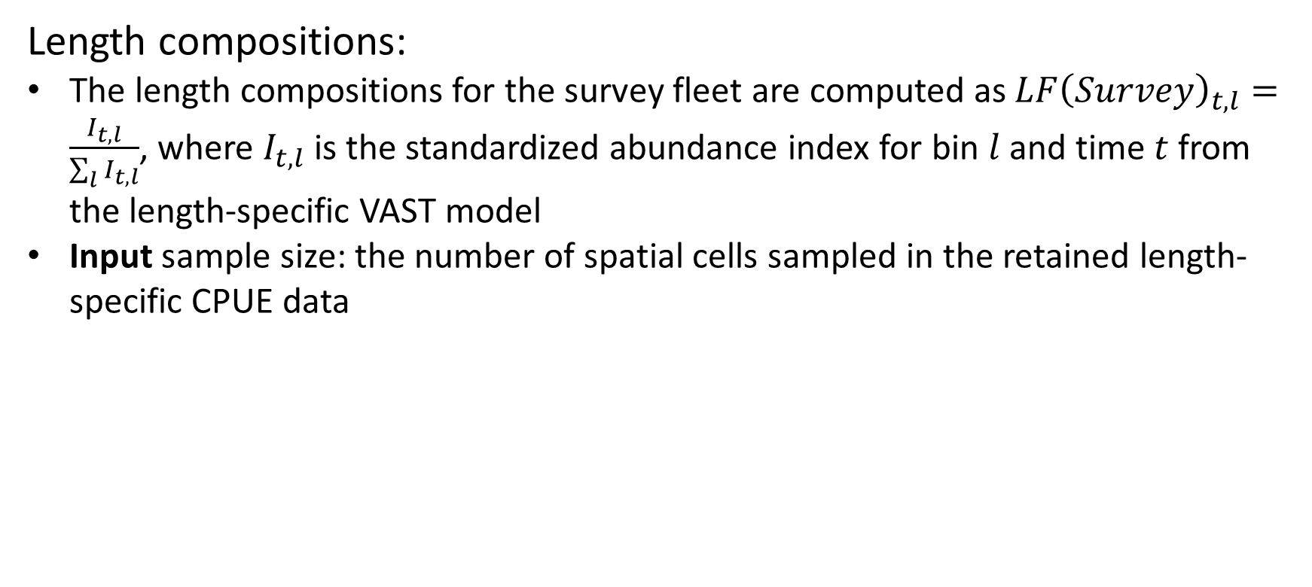
Data: survey fleet
Length compositions:
The length compositions for the survey fleet are computed as $LF{\left(Survey\right)}_{t,l}=\frac{I_{t,l}}{\sum_{l}{I_{t,l}}}$, where $I_{t,l}$ is the standardized abundance index for bin $l$ and time $t$ from the length-specific VAST model
Input sample size: the number of spatial cells sampled in the retained length-specific CPUE data

Slide 15
Model configurations
All biological parameters are fixed at their true values (steepness, M, and G are confounded and are difficult to estimate within the assessment model)
Recruitment deviations are estimated for every model year and are assumed to sum to zero
Age-specific selectivity is used in order to be consistent with the simulation model
Selectivity is assumed to be asymptotic for the survey (longline) fleet and dome-shaped (could be asymptotic) for all, including longline, fishery fleets: logistic for asymptotic selectivity and double-normal for dome-shaped selectivity
Lack of composition data for the troll fishery: all three troll fleets share the same selectivity
Initial conditions: the stock is assumed to be harvested from an equilibrium unfished condition

Slide 16
How to fit the model to data
Building the SS data file:
Load the original provided 1-region (for models one) or 4-region (for models region and tree) SS data file into the R environment
Add a survey fleet (including adding its abundance index and length comps) and delete tagging data
For regression-tree models only: run the regression tree algorithm to redefine associated PS fleets based on simulated 5*5 LF data for associated PS (extracted from the original provided cell-level data)
Change the length comps of associated PS fleets (catch-weighted vs. sample-weighted; one fleet vs. region-specific fleets vs. regression-tree fleets)
For regression-tree models only: change the catches of associated PS fleets
Write the new SS data file using function SS_writedat from R package r4ss

Slide 17
How to fit the model to data
Running the six SS models: each of the six models needs to run three times in order to get its final estimates:
Run with LF weight = 1 (based on input sample size)
Run with LF weight = Francis
Run with LF weight = Francis and suggested recruitment bias adjustment from r4ss

Slide 18
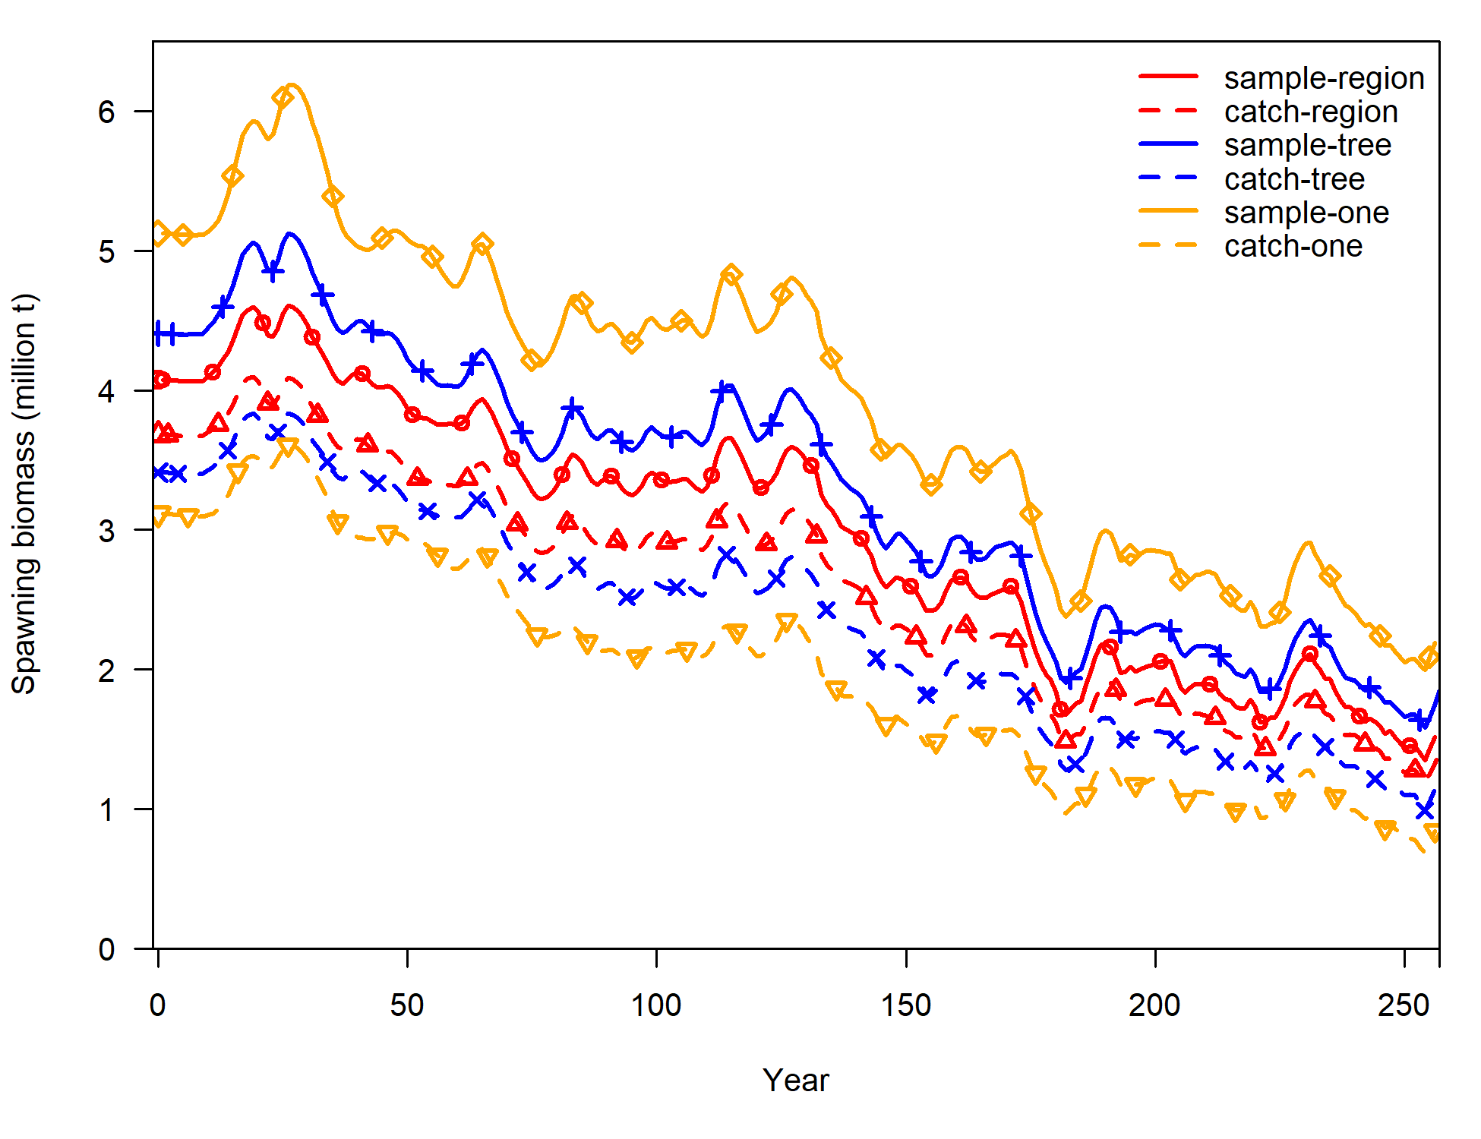
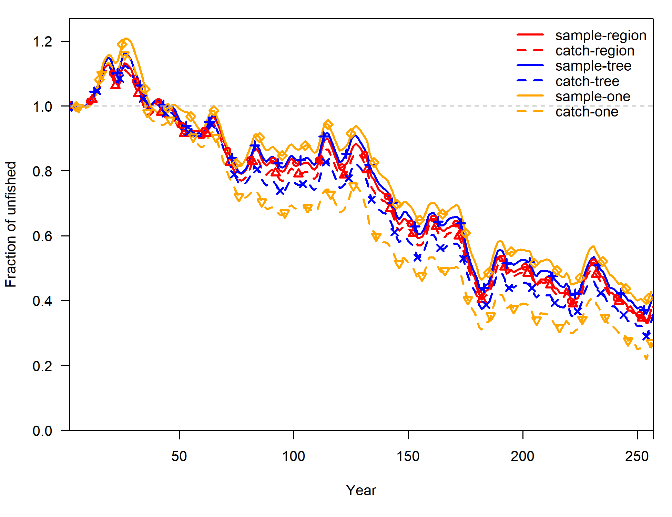
Model results
 | One fishery per gear/set type | Region-specific fisheries | Regression-tree fisheries
Fishery’s length comps for associated PS: sample weighted | Model sample-one | Model sample-region | Model sample-tree
Fishery’s length comps for associated PS: catch weighted | Model catch-one | Model catch-region | Model catch-tree

Slide 19
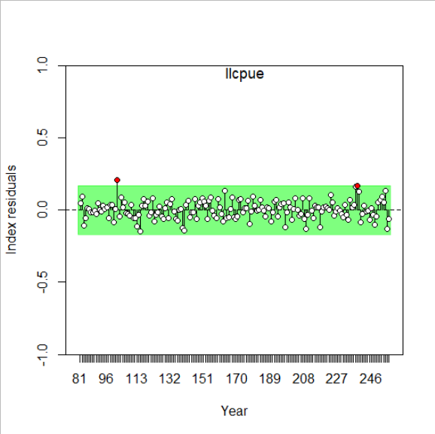
Model diagnostics: runs test
 | One fishery per gear/set type | Region-specific fisheries | Regression-tree fisheries
Fishery’s length comps for associated PS: sample weighted | Model sample-one | Model sample-region | Model sample-tree
Fishery’s length comps for associated PS: catch weighted | Model catch-one | Model catch-region | Model catch-tree
Case study
Using function SSplotRunstest from R package ss3diags (https://github.com/PIFSCstockassessments/ss3diags)

Slide 20
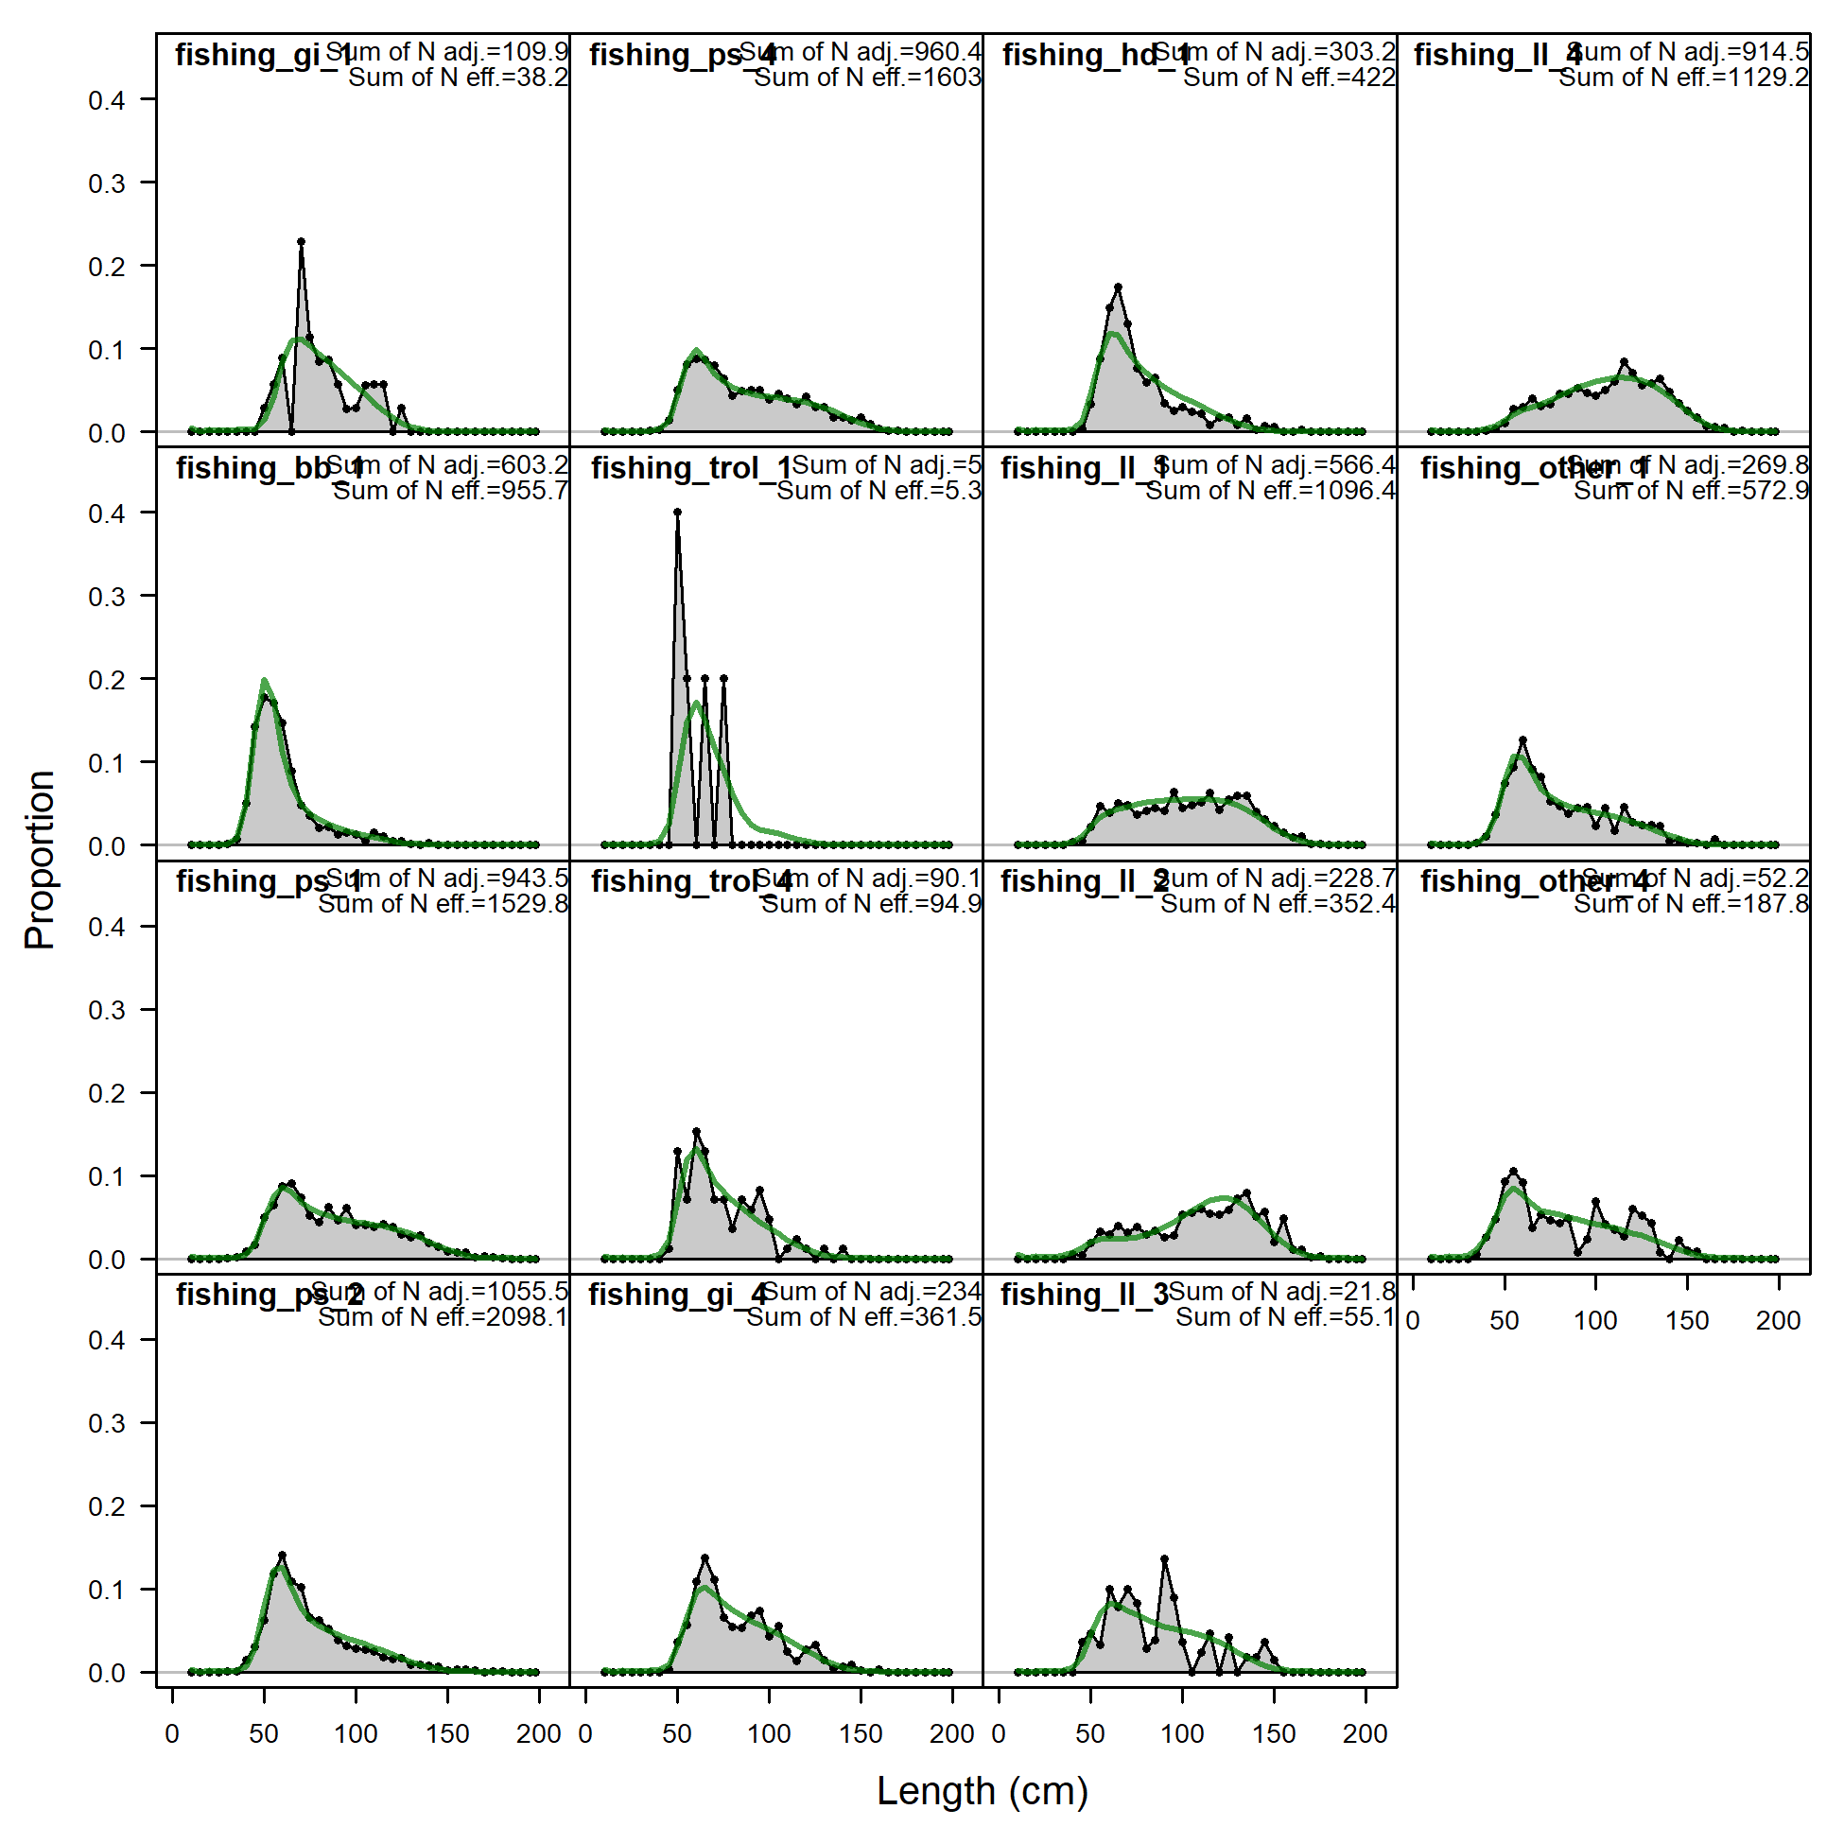
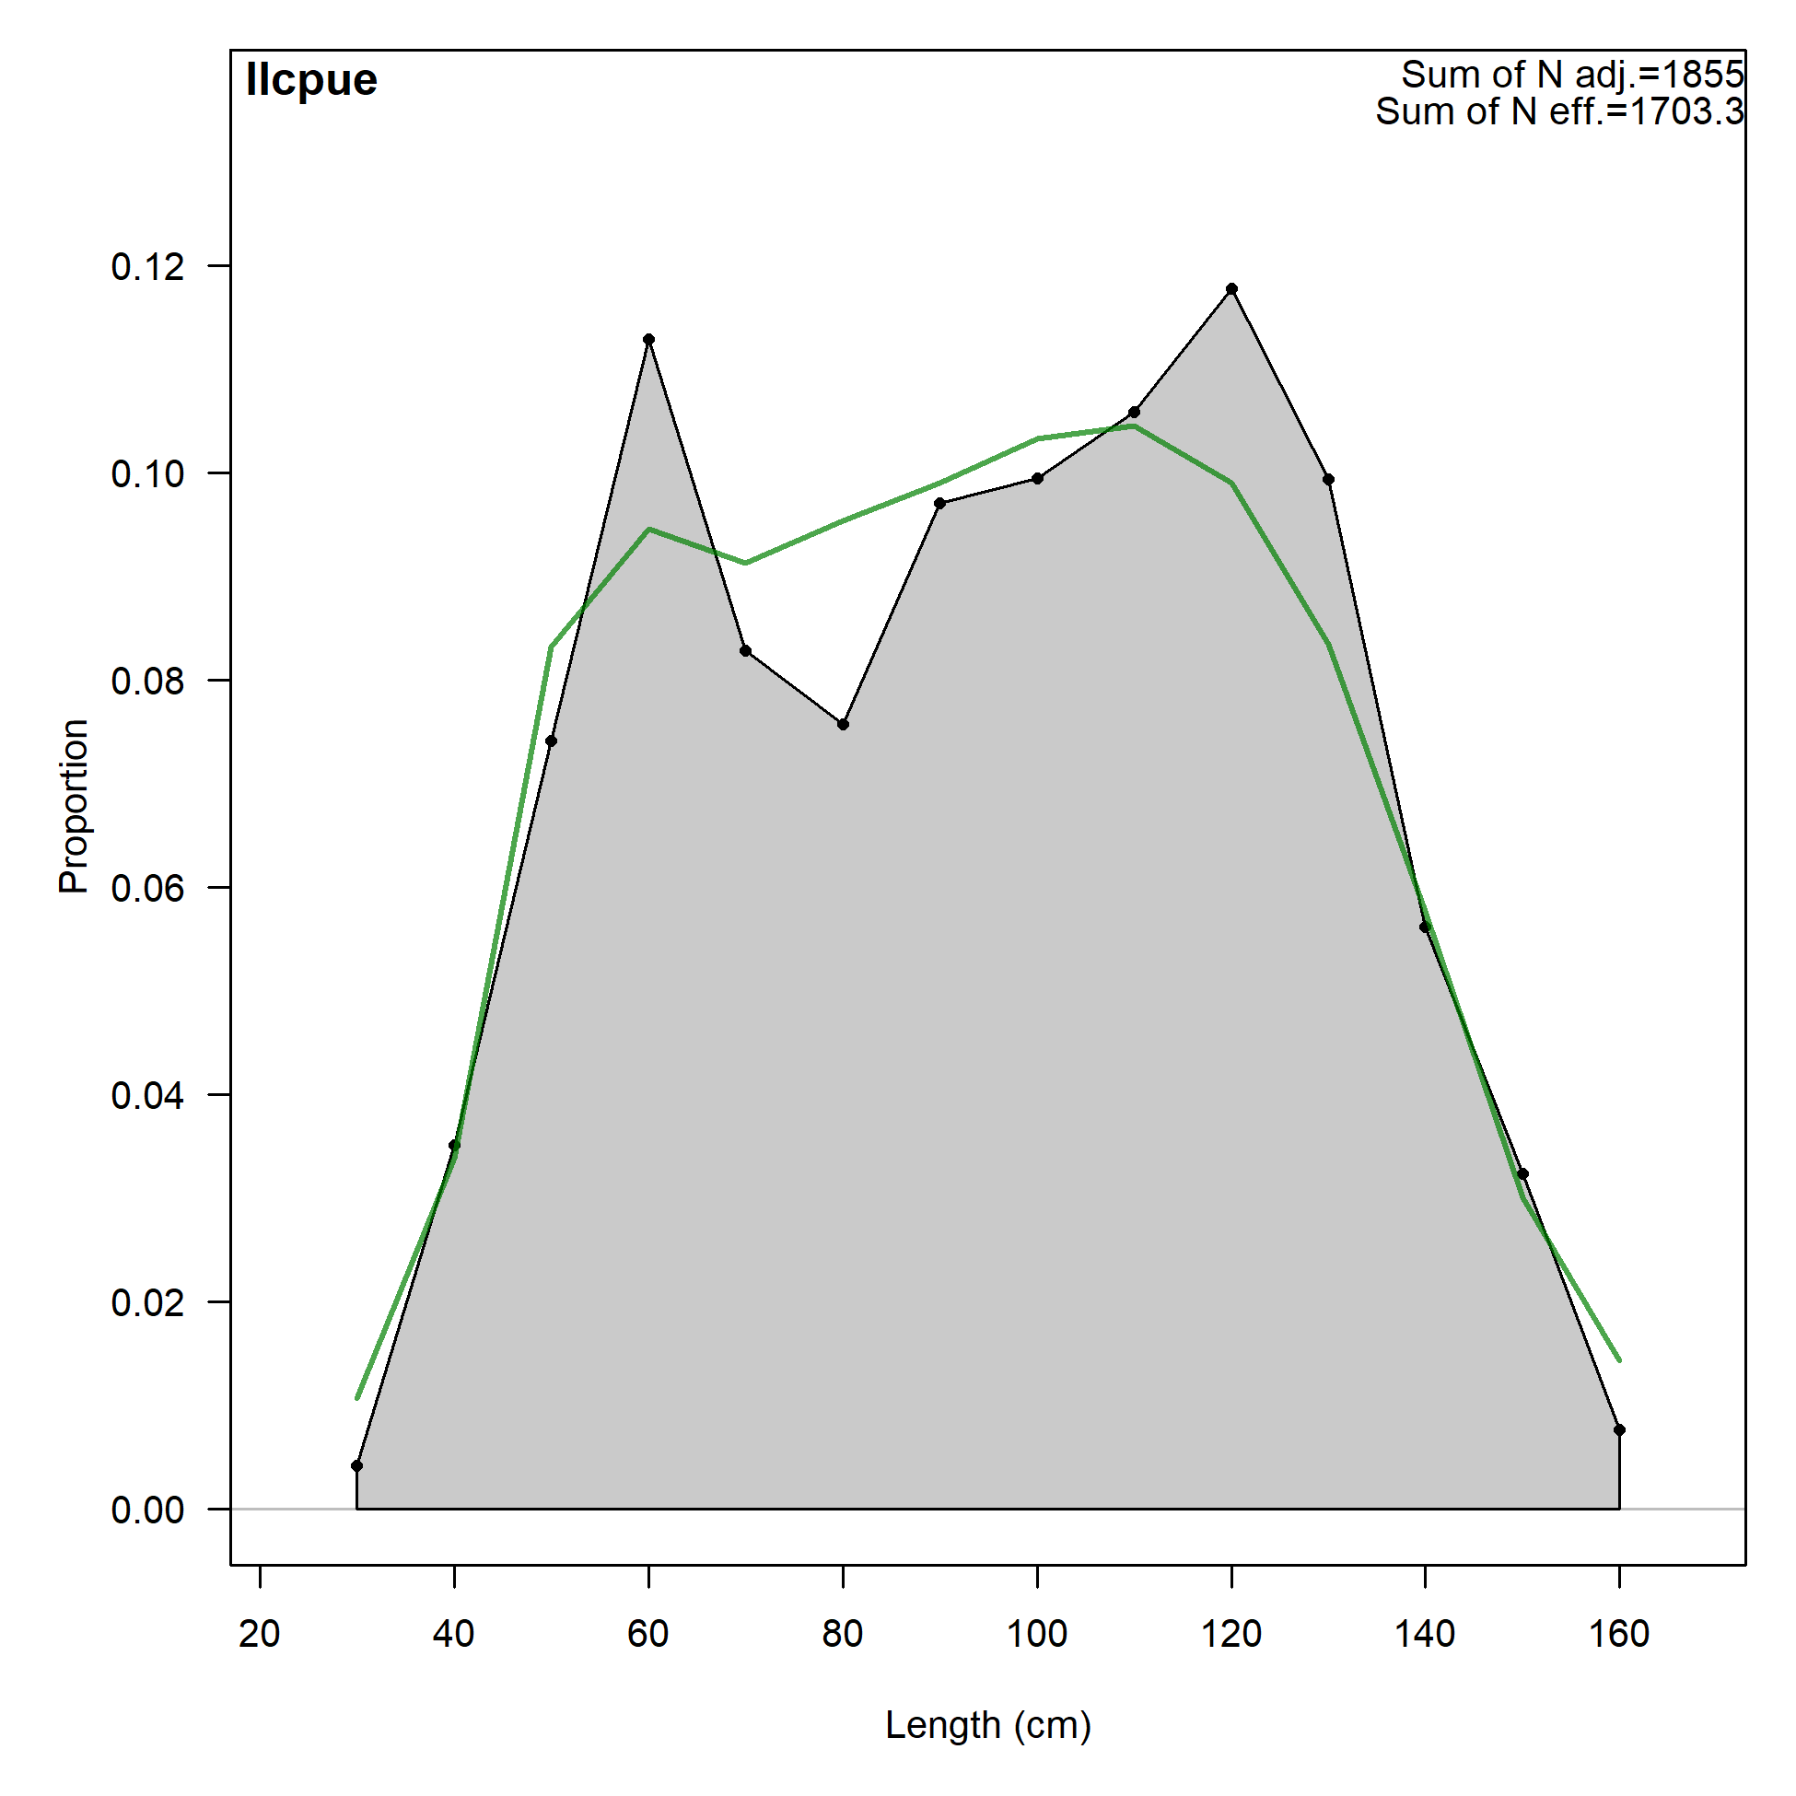
Model diagnostics: fit to LF (fisheries and survey)

Slide 21
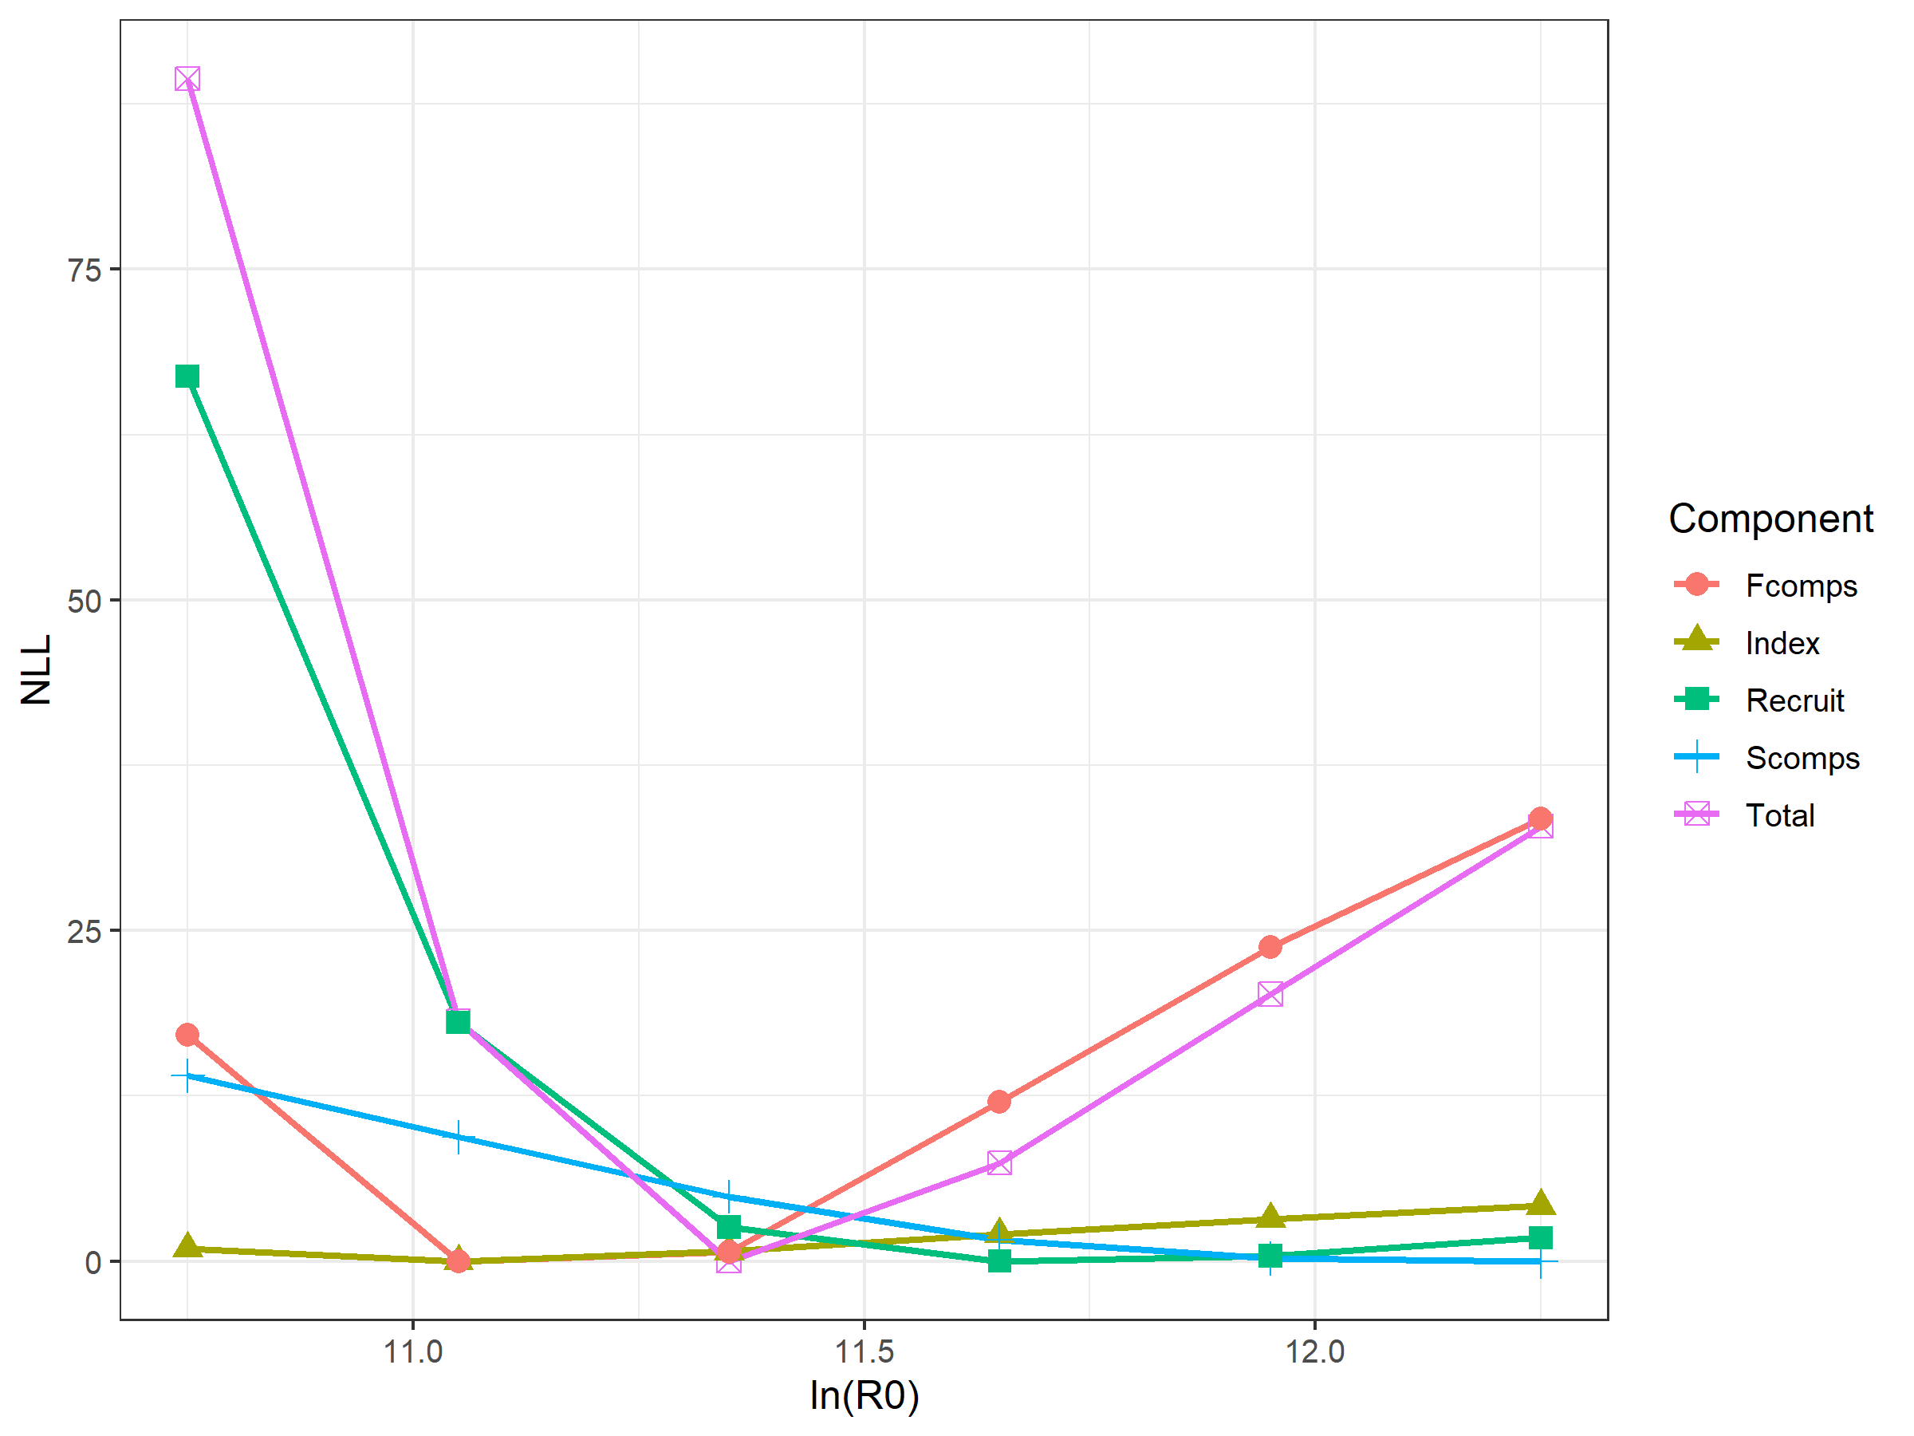
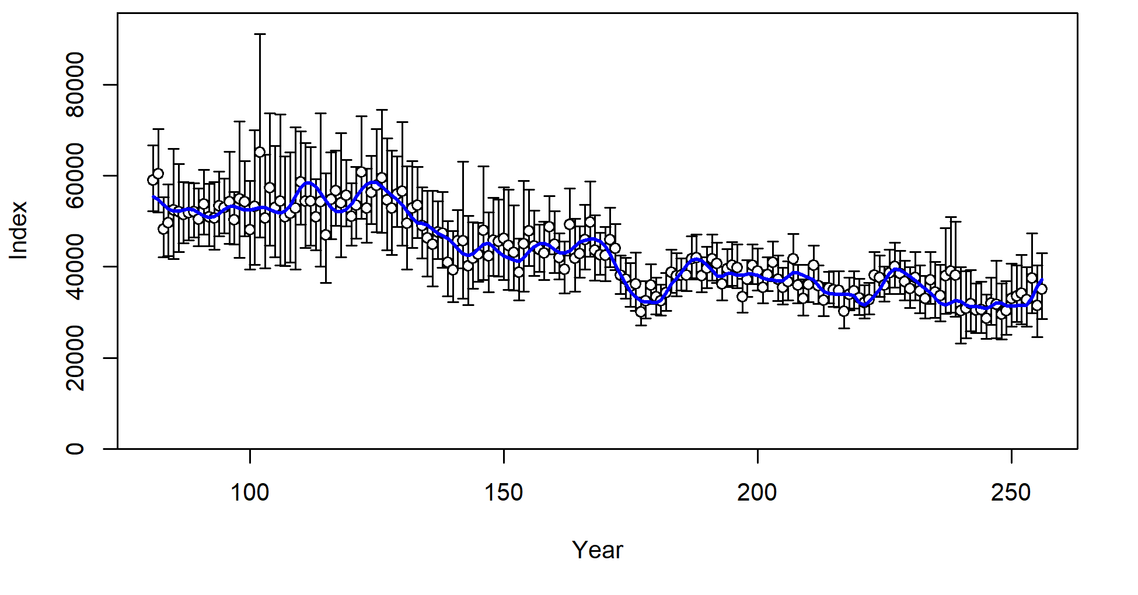
Model diagnostics: R0 likelihood profile
The components of the total likelihood include fishery compositions (Fcomps), survey compositions (Scomps), survey abundance index (Index), and recruitment penalty (Recruit).

Slide 22
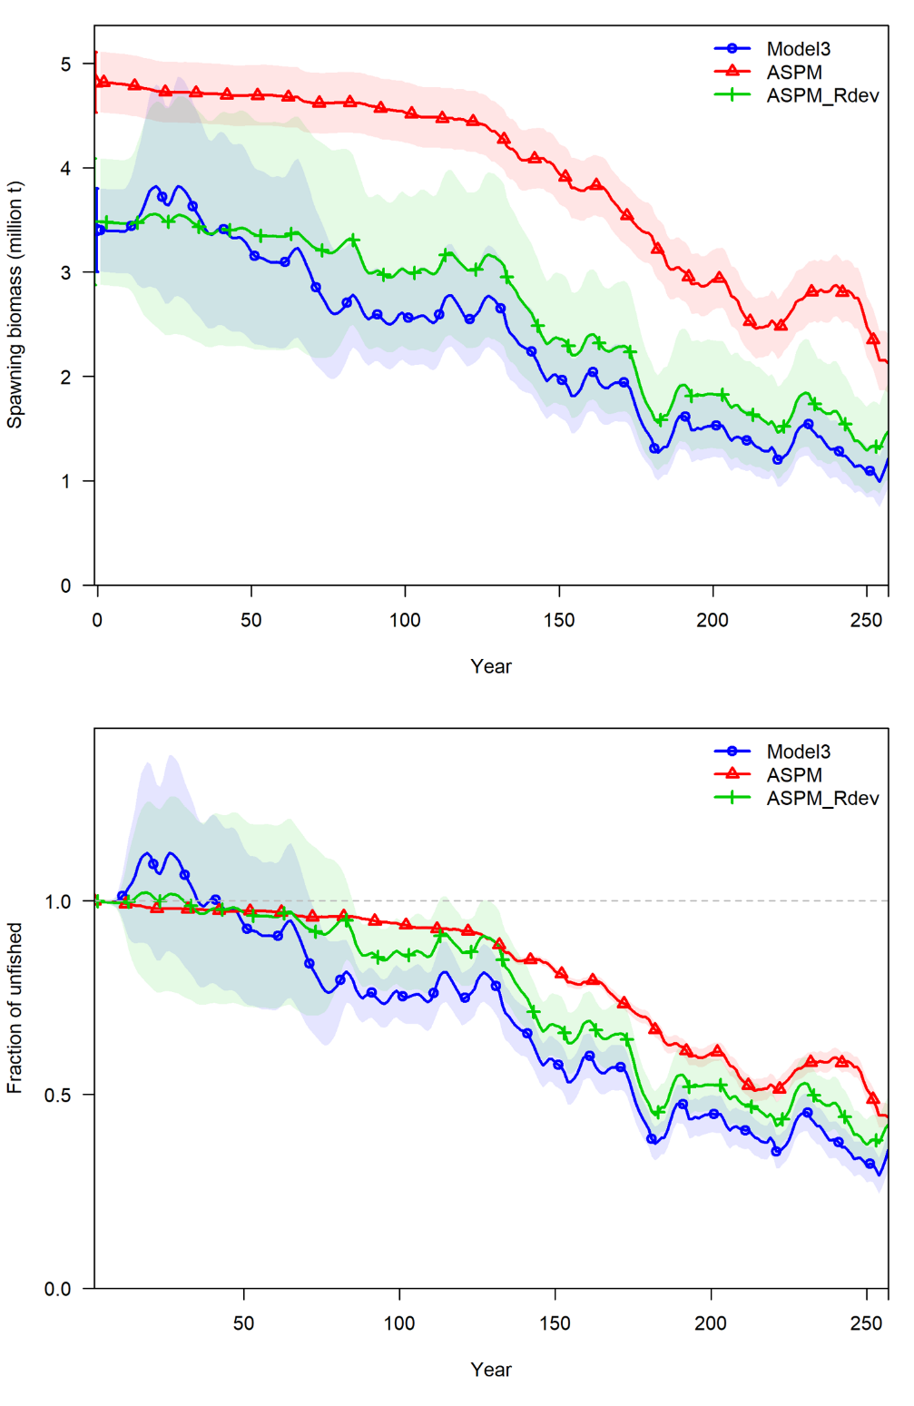
Model diagnostics: ASPM (CCA does not converge)

Slide 23
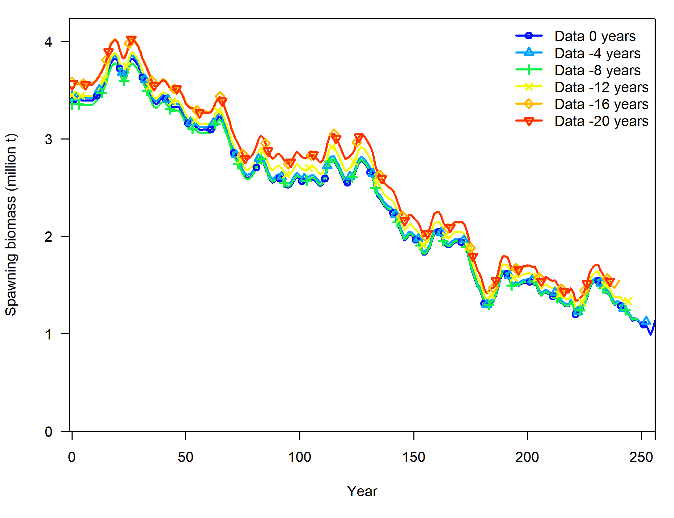
Model diagnostics: retrospective pattern

Slide 24
Results: single replicate
The six models suggest notably different time series of spawning biomass but similar time series of spawning biomass ratio
The two models which ignore “areas-as-fleets” have the most extreme estimates of spawning biomass
The examined model (model catch-tree) in the case study fits well to data based on model diagnostics

Slide 25
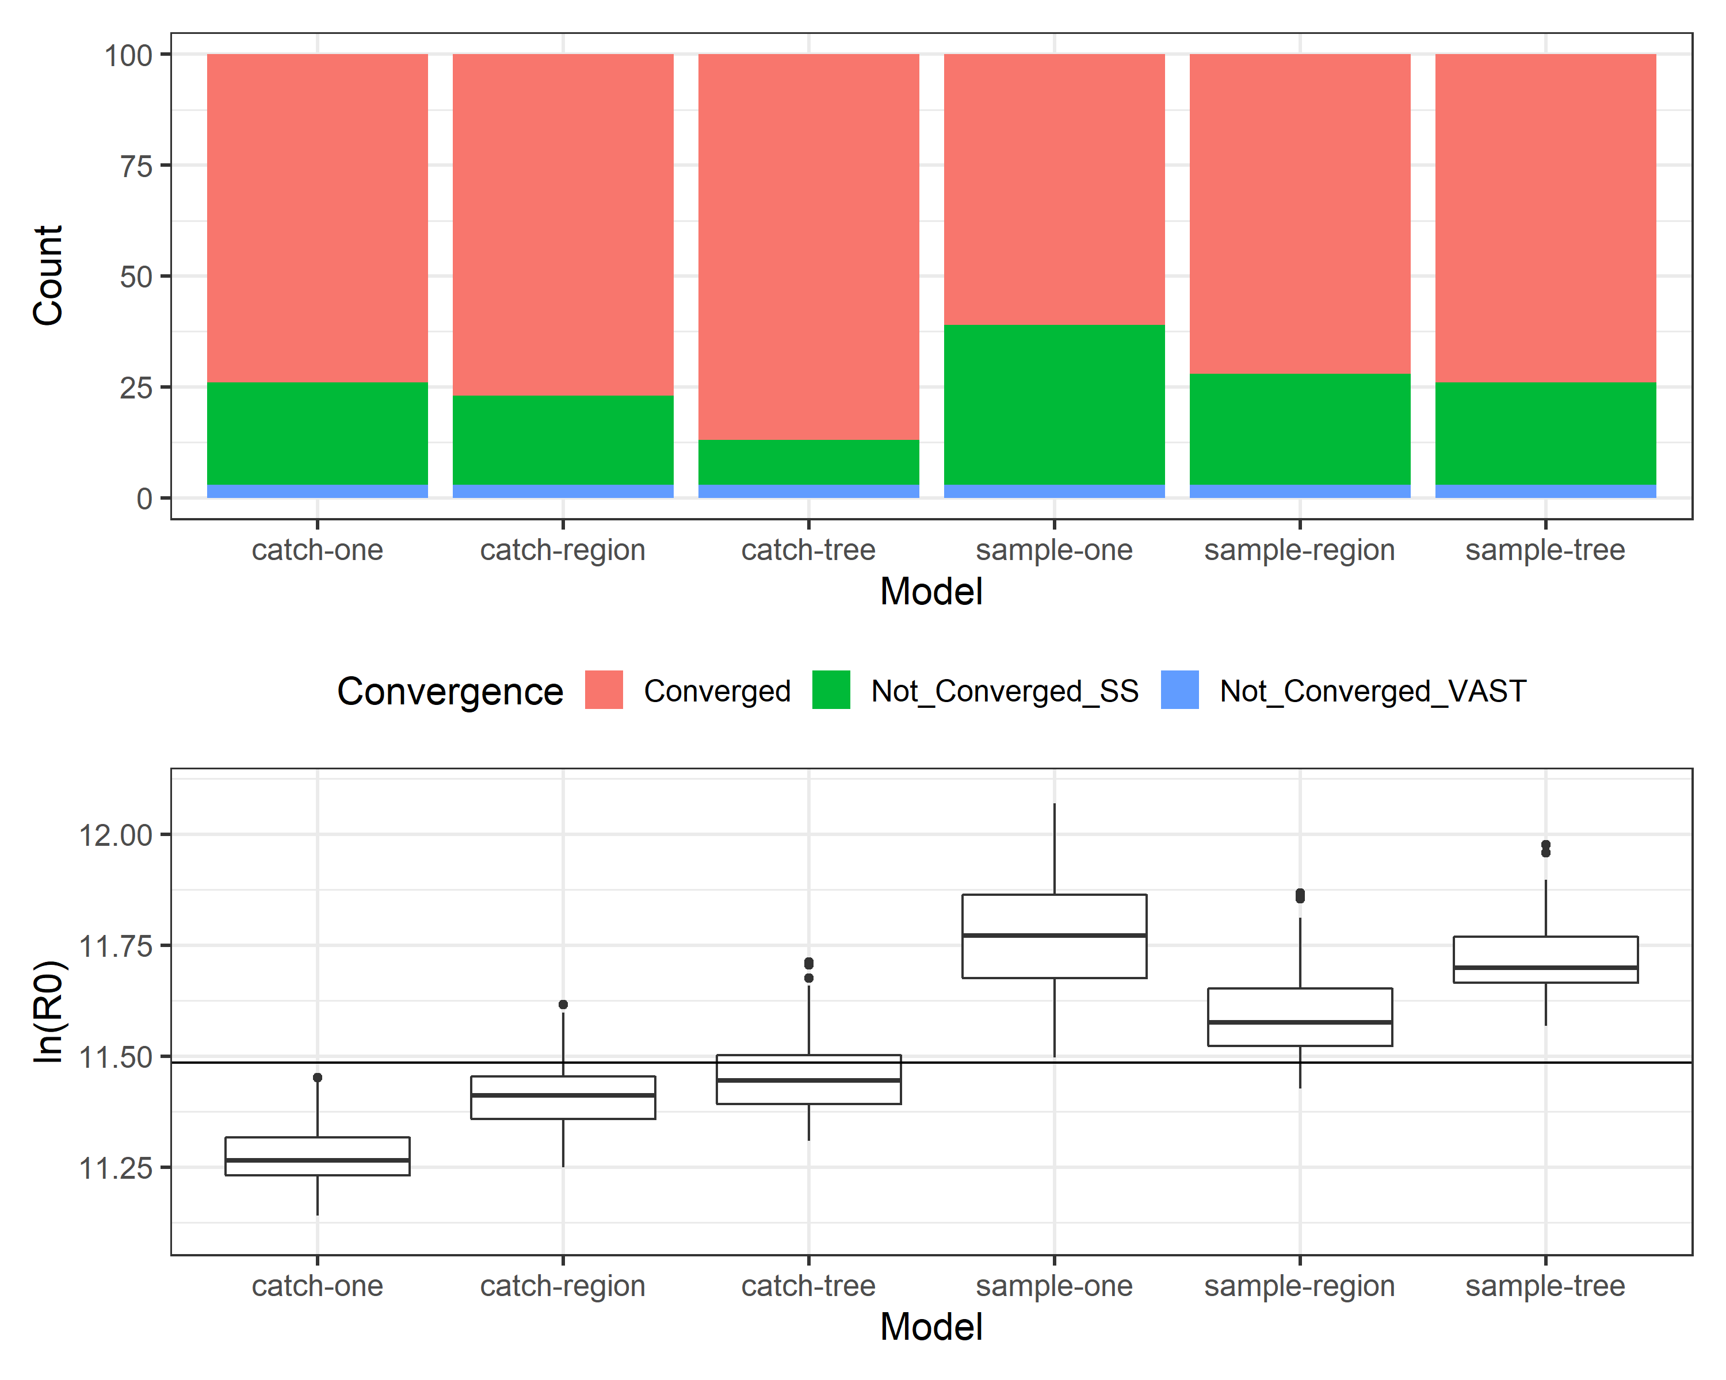
Expand to the 100 replicates: convergence rate
 | One fishery per gear/set type | Region-specific fisheries | Regression-tree fisheries
Fishery’s length comps for associated PS: sample weighted | Model sample-one | Model sample-region | Model sample-tree
Fishery’s length comps for associated PS: catch weighted | Model catch-one | Model catch-region | Model catch-tree
Regression-tree defines identical associated PS fisheries among replicates

Slide 26
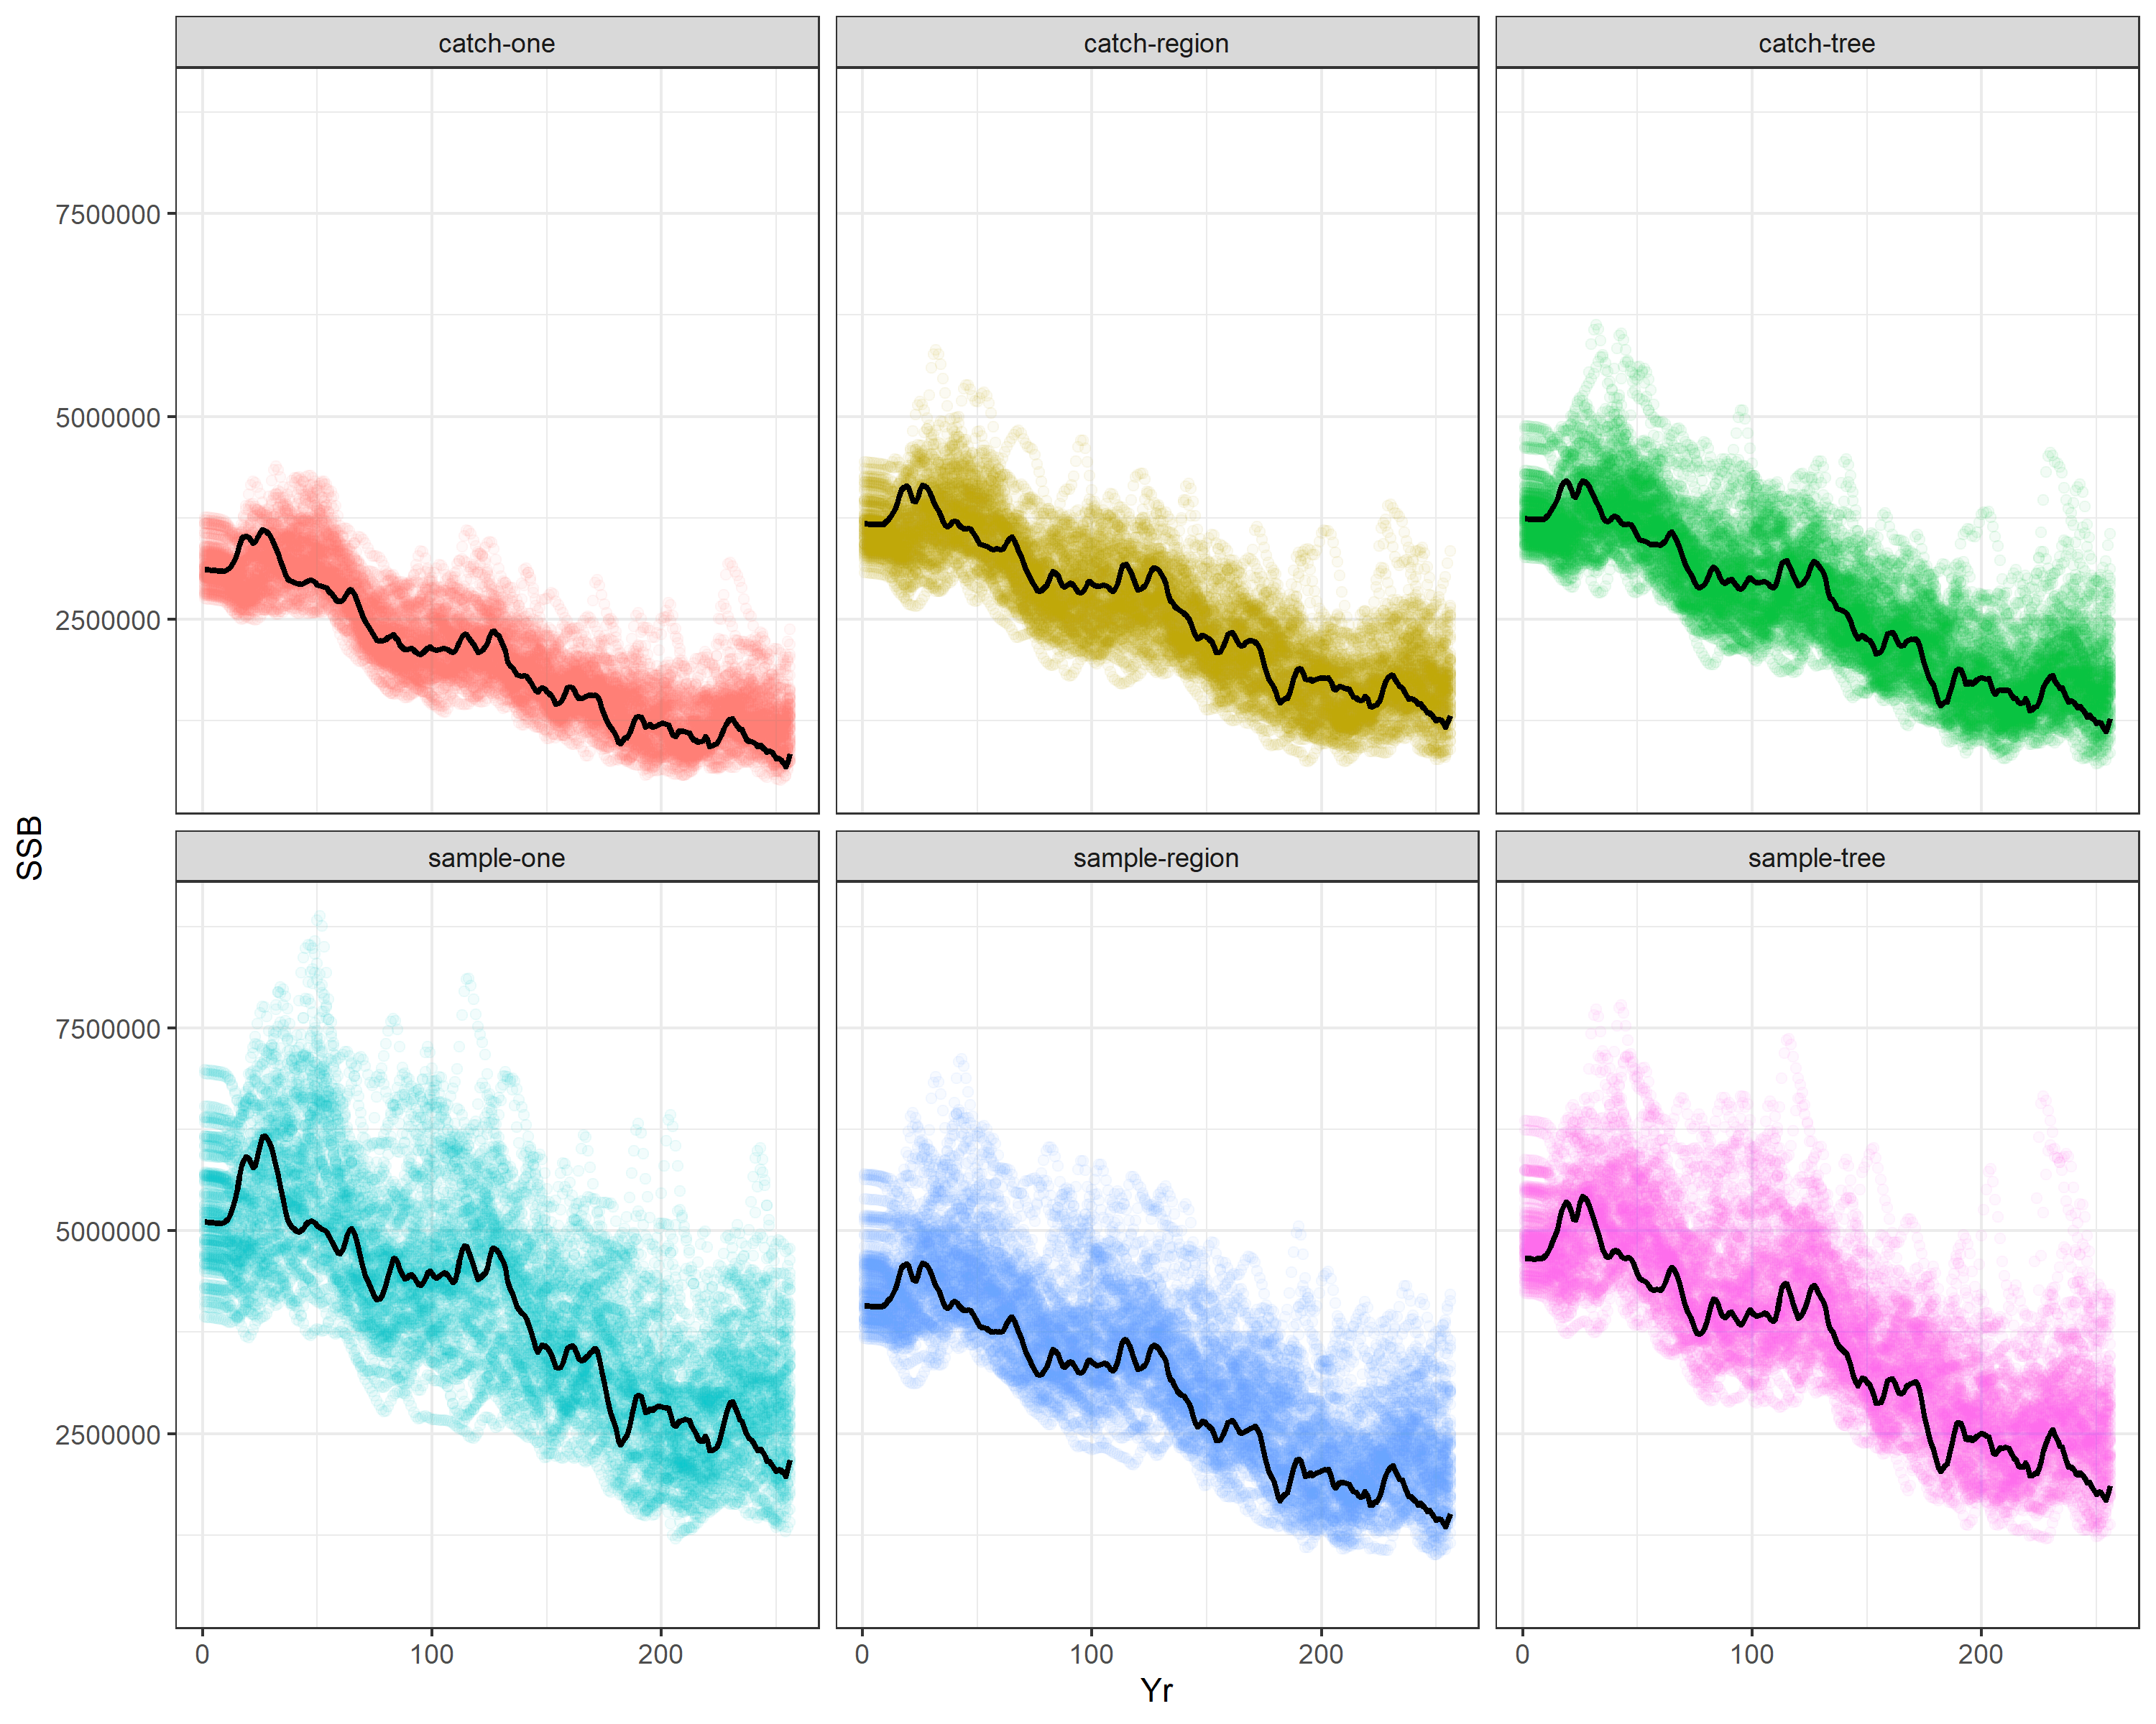
Expand to the 100 replicates: SB trajectories
 | One fishery per gear/set type | Region-specific fisheries | Regression-tree fisheries
Fishery’s length comps for associated PS: sample weighted | Model sample-one | Model sample-region | Model sample-tree
Fishery’s length comps for associated PS: catch weighted | Model catch-one | Model catch-region | Model catch-tree
Black line marks the example replicate

Slide 27
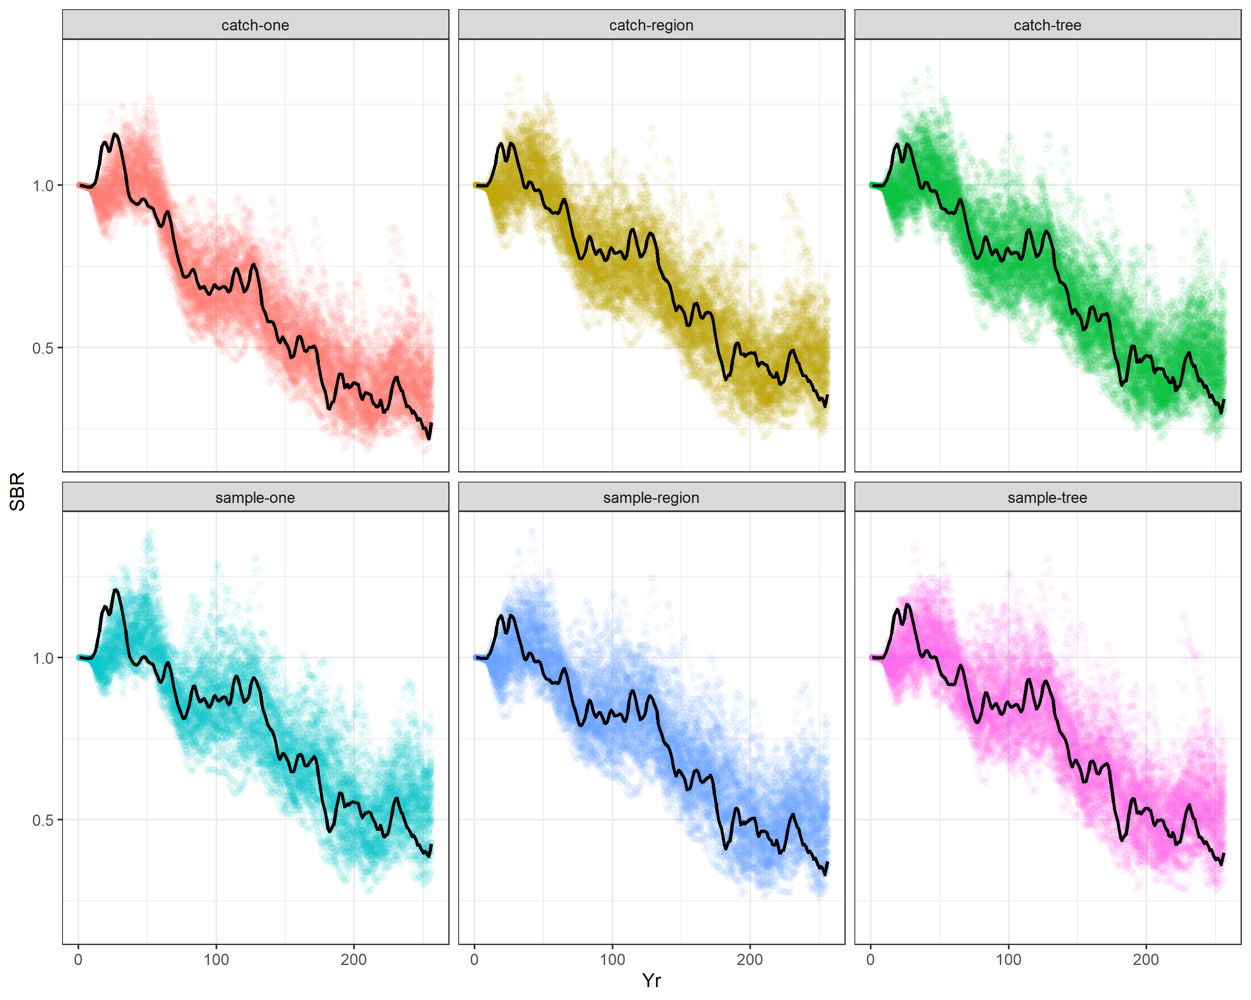
Expand to the 100 replicates: SB ratio trajectories
 | One fishery per gear/set type | Region-specific fisheries | Regression-tree fisheries
Fishery’s length comps for associated PS: sample weighted | Model sample-one | Model sample-region | Model sample-tree
Fishery’s length comps for associated PS: catch weighted | Model catch-one | Model catch-region | Model catch-tree
Black line marks the example replicate

Slide 28
Expand to the 100 replicates
 | One fishery per gear/set type | Region-specific fisheries | Regression-tree fisheries
Fishery’s length comps for associated PS: sample weighted | Model sample-one | Model sample-region | Model sample-tree
Fishery’s length comps for associated PS: catch weighted | Model catch-one | Model catch-region | Model catch-tree
We compare the estimate of R0 with its true value to evaluate model performance
True value

Slide 29
Expand to the 100 replicates
 | One fishery per gear/set type | Region-specific fisheries | Regression-tree fisheries
Fishery’s length comps for associated PS: sample weighted | Model sample-one | Model sample-region | Model sample-tree
Fishery’s length comps for associated PS: catch weighted | Model catch-one | Model catch-region | Model catch-tree
Ignoring “areas-as-fleets” results in worst convergence and most biased ln(R0)

Slide 30

Expand to the 100 replicates
 | One fishery per gear/set type | Region-specific fisheries | Regression-tree fisheries
Fishery’s length comps for associated PS: sample weighted | Model sample-one | Model sample-region | Model sample-tree
Fishery’s length comps for associated PS: catch weighted | Model catch-one | Model catch-region | Model catch-tree
Ignoring “areas-as-fleets” results in worst convergence and most biased ln(R0)
In comparison to sample-weighted length comps, catch-weighted length comps leads to better convergence and less biased ln(R0)

Slide 31
Expand to the 100 replicates
 | One fishery per gear/set type | Region-specific fisheries | Regression-tree fisheries
Fishery’s length comps for associated PS: sample weighted | Model sample-one | Model sample-region | Model sample-tree
Fishery’s length comps for associated PS: catch weighted | Model catch-one | Model catch-region | Model catch-tree
Ignoring “areas-as-fleets” results in worst convergence and most biased ln(R0)
In comparison to sample-weighted length comps, catch-weighted length comps leads to better convergence and less biased ln(R0)
Given length comps are catch-weighted, regression-tree defined fisheries correspond to better convergence and less biased ln(R0)

Slide 32
Expand to the 100 replicates
 | One fishery per gear/set type | Region-specific fisheries | Regression-tree fisheries
Fishery’s length comps for associated PS: sample weighted | Model sample-one | Model sample-region | Model sample-tree
Fishery’s length comps for associated PS: catch weighted | Model catch-one | Model catch-region | Model catch-tree
Ignoring “areas-as-fleets” results in worst convergence and most biased ln(R0)
In comparison to sample-weighted length comps, catch-weighted length comps leads to better convergence and less biased ln(R0)
Given length comps are catch-weighted, regression-tree defined fisheries correspond to better convergence and less biased ln(R0)
The best approach: “areas-as-fleets”; regression-tree defined fisheries; catch-weighted fishery’s length comps

Slide 33
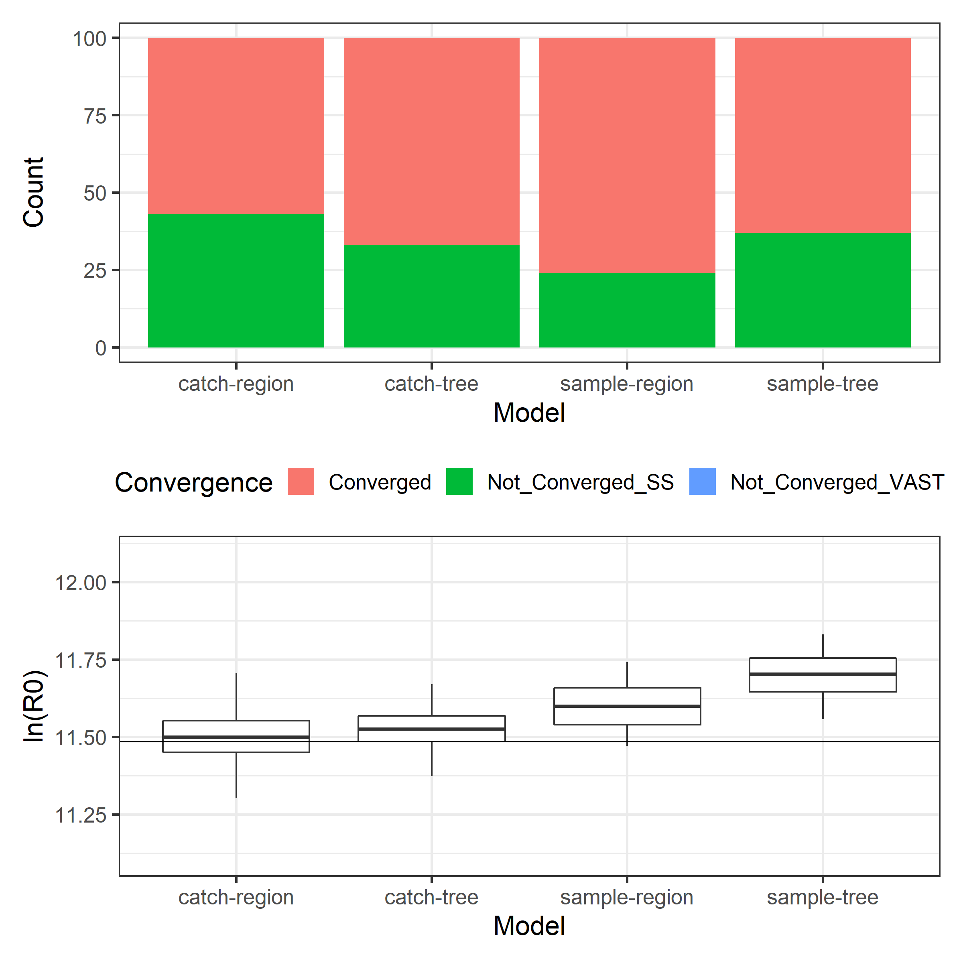
Expand to the 100 replicates (ESS: 5 (left) vs. 25 (right))
 | One fishery per gear/set type | Region-specific fisheries | Regression-tree fisheries
Fishery’s length comps for associated PS: sample weighted | Model sample-one | Model sample-region | Model sample-tree
Fishery’s length comps for associated PS: catch weighted | Model catch-one | Model catch-region | Model catch-tree
lower convergence rate; similar accuracy; higher precision
Bias is likely not caused by low sample size

Slide 34
Discussion
We compared model performance solely based on the estimate of R0 because its true value is known.
More estimated vs. true comparisons based on other estimated parameters/derived quantities (e.g., F, SB, and SB/SB0) are needed to further evaluate model performance.

Slide 35
Discussion
Why we use this approach (SS3 areas-as-fleets × VAST) in the IATTC assessments?
Our available tagging data is limited in both space and time to reliably inform movement rates within the EPO.

Slide 36
Discussion
Parsimony: how many fisheries per gear/set type?
Results suggest that one may not be enough but how many are good enough (not overfitting)?
The low spatial resolution (10 * 20) of LL length comp data limits the use of the regression tree approach to defining LL fishery fleets

Slide 37
Discussion
Diagnostics: whether this non-spatial approach is adequate to account for spatial processes?
This non-spatial approach (assuming the stock is well-mixed) may be less reliable when signs suggest there is obvious local population dynamics (i.e., local depletion)

Slide 38
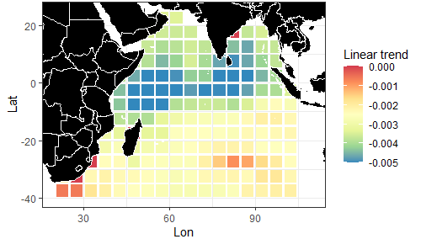
Discussion
Diagnostics: whether this non-spatial approach is adequate to account for spatial processes?
Relative depletion based on standardized LL CPUE
A sign of local depletion

Slide 39
Discussion
Diagnostics: whether this non-spatial approach is adequate to account for spatial processes?
This non-spatial approach (assuming the stock is well-mixed) may be less reliable when signs suggest there is obvious local population dynamics (i.e., local depletion)
This non-spatial approach (assuming the abundance index and associated length comps are for the entire population) may be less reliable when the spatial coverage of fishery-dependent data (e.g., CPUE) is limited or shift systematically over time (preferential-sampling under increasingly depleted stock)

Slide 40


Questions?

